Slide 1
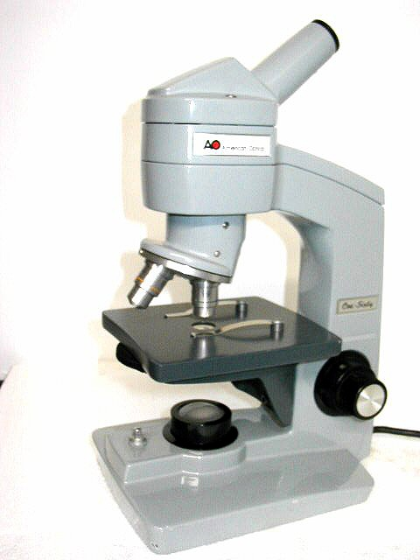
Microscope
1
Eyepiece, ocular lens
bodytube
2
Revolving nosepiece
13
arm
3
12
Objective lens
Stage clips
4
11
stage
5
Course adjustment
10
diaphragm
Fine adjustment
6
Light switch
9
light
8
base
7

Slide 2
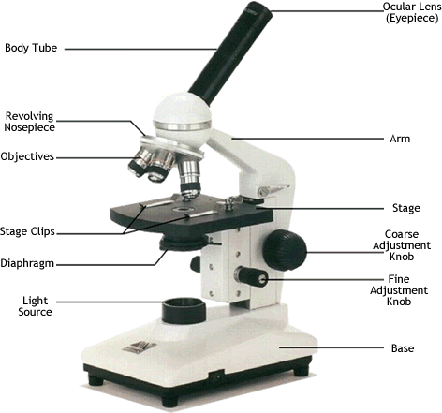

Slide 3
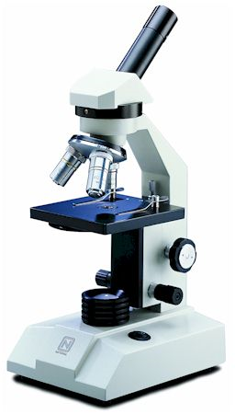
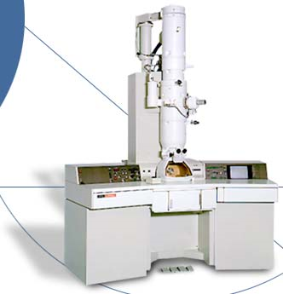
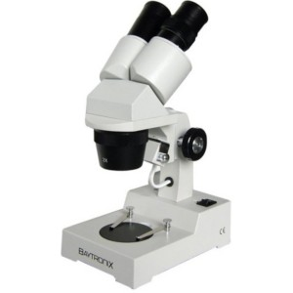
Types of Microscopes
Binocular microscope
Light microscope
Electron microscope

Slide 4
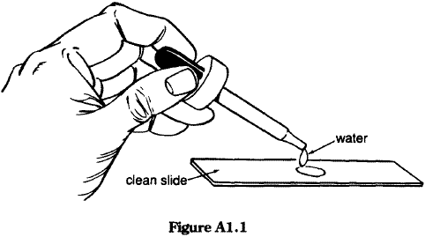
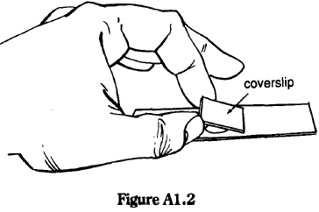
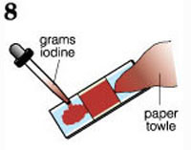
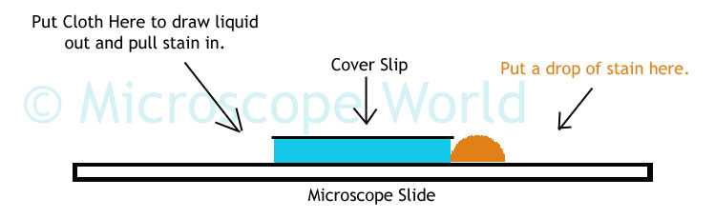
Making a slide
Goal: clean slides, no air bubbles, no sloppy water on slide

Slide 5
Getting into Focus
1. Plug in the microscope and press the light button.
2. Click the low power objective (10x) into position.
3. Place the slide and specimen directly over the hole on the stage.
4. Use the coarse adj. (large knob) make sure the objective is down as far as it will go.
5. Look into the eyepiece with one eye, keeping both eyes open.
6. Using the coarse adjustment, slowly move the objective upward to focus the image. You may have to move the slide to find the image. If the image is not in focus at this point, repeat step 4-6.

Slide 6
Getting into Focus
7. Check the diaphragm setting for the best light contrast.
8. Center the image in the low power field of view.
9. Place the stage clips over the slide.
10. Finish focusing using the fine adjustment (small knob).

Slide 7
To magnify the image more, use the high power objective
Looking from the side, swing the high power objective into position.
DO NOT TOUCH THE COARSE ADJUSTMENT
Use the fine adjustment to focus the image
Adjust the diaphragm
If you should lose the focus, repeat steps 4-10

Slide 8
Video: “Incredible World”
What piece of technology improved the lives of humans?
  What advancements in the technology occurred?
  How were humans helped?

Slide 9
Microscope Terms
1. Image
    What we see under the microscope
2. Magnification
    Ratio of image size to object size
3. Resolution
    Sharpness of image
4. Micrometer (micron)
    Unit of measurement for microscopes
    Symbol: µ
    1mm = 1000 µ

Slide 10
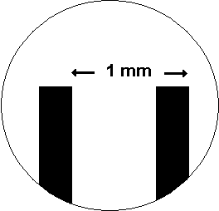

Micron Lab Directions
Field of View
Measure the width at the thinnest part of the maple leaf

